Slide 1

Taking Digital Service by Storm: from Traditional AI to Deep AI
Qing Wang, Laura Shwartz, DE
IBM Thomas J. Watson Research Center

Slide 2
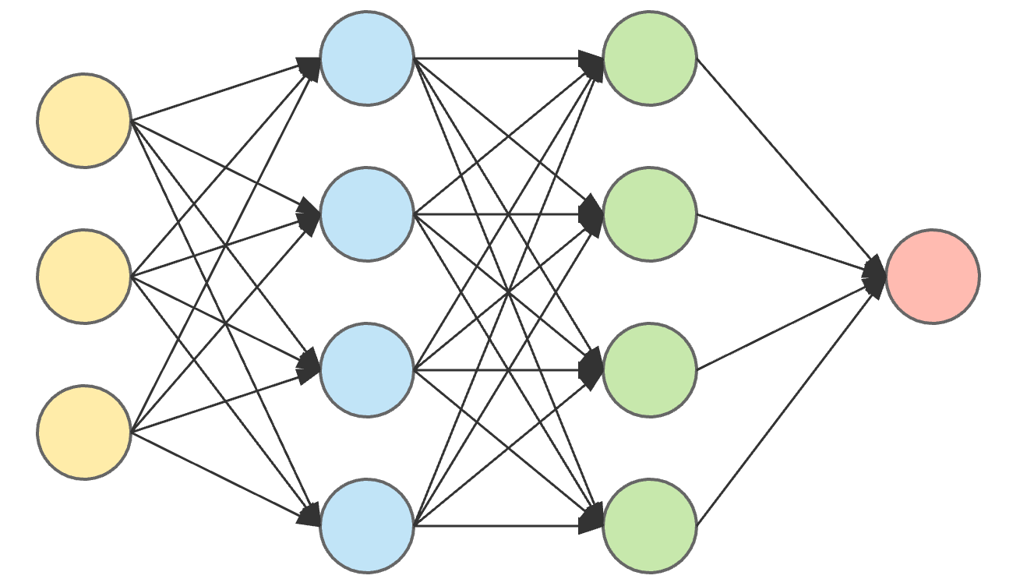
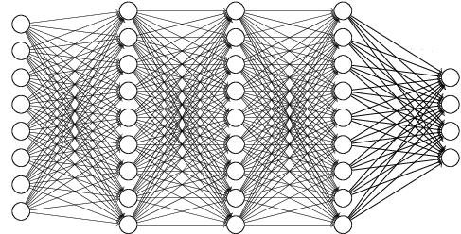
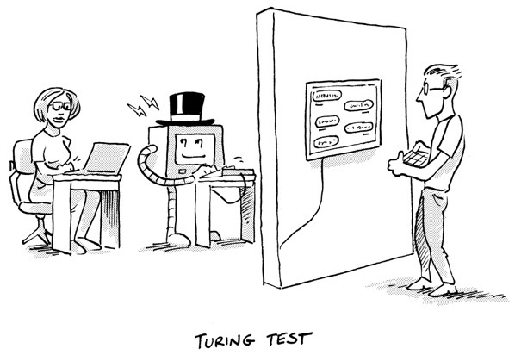
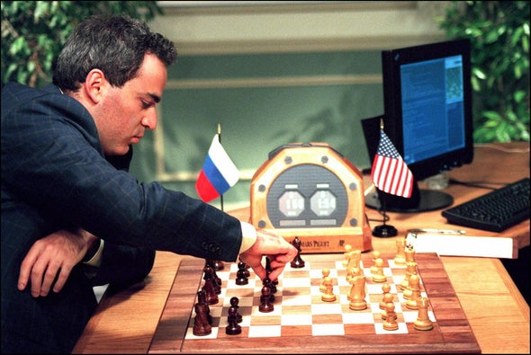
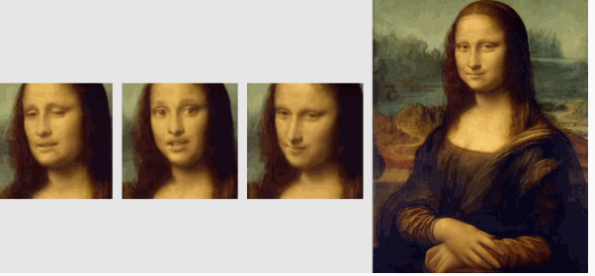
Evolution of Artificial Intelligence
Small Processing Power
Large Processing Power
Simple Neural Network
Deep Neural Network
1950s-1980s
1980s-1990s
1990s-2000s
2000s-Present
The First AI Boom
The Second AI Boom
The Third AI Boom
Notes:
The age of search and deductive reasoning
The first AI boom: AI programs are able to solve only trivial “toy” programs but hardly any practical ones.
Turing test, perceptron is developed.
The age of knowledge acquisition
The second AI boom: Researchers tried to teach machines the knowledge of experts, which turned out to be extremely difficult.
AI defeats world chess champion against the IBM Deep Blue chess computer.
Back propagation algorithm, and Bayesian network.
The age of machine learning
The third AI boom Into the age where computers acquire knowledge form data not from data not from humans by machine learning.
Deep learning is spotlight. Samsung AI, they use GANs to animate quite realistic talking sequences of a head shot

Slide 3
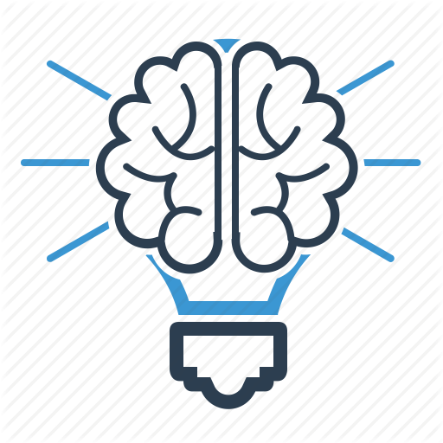
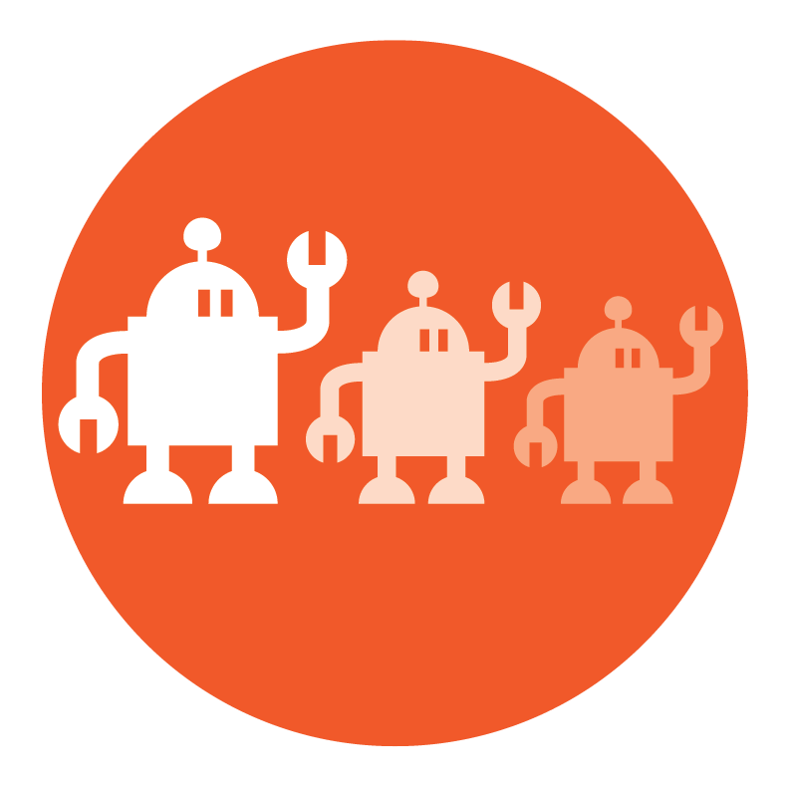


Cognitive Brain in Digital Services
“Cognitive Brain”
Understands, reasons and learns from data
1. Learn knowledge from human engineers
2. Learn knowledge from
virtual engineers
smarter
expert knowledge
Automatic Service Management
operational data
Human Engineer
execute tough tasks
Virtual Engineer
execute automations
advices
recommendation

Slide 4



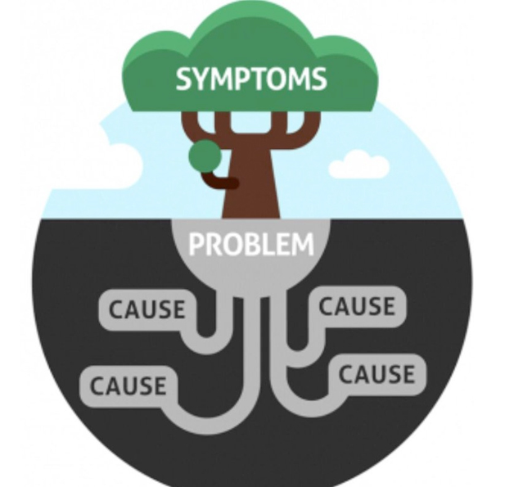
A Case Study
Problem Determination
Problem Diagnosis
Problem Resolution
Food Savety Experts

